Slide 1
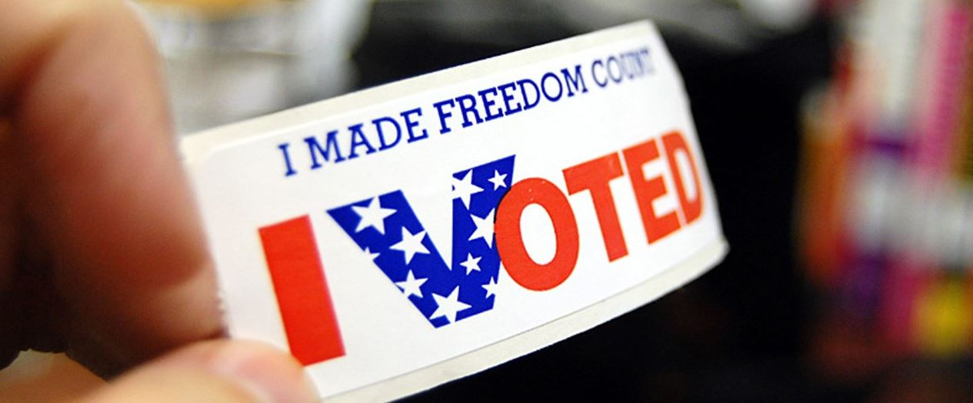
Preparing for the Primary
Secretary of State’s Office
TAEA Mid-Winter Conference 2020

Slide 2
Outline
Litigation Update
E-Pollbook Certification
Election Security Best Practices
Voter Registration
Early Voting Requirements
Web Posting Requirements
Primary Responsibilities

Slide 3
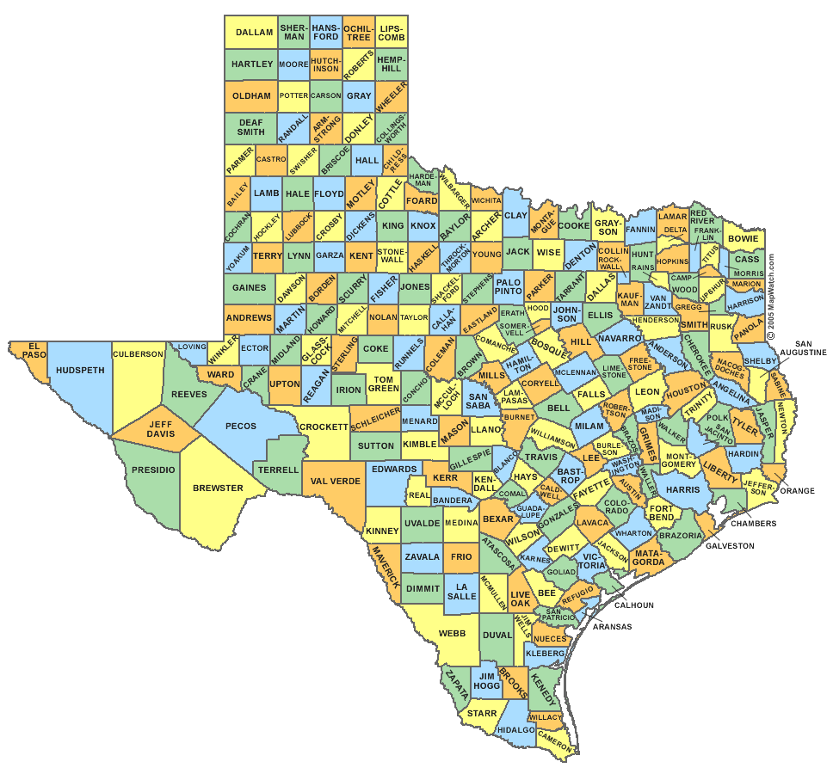
Texas By the Numbers
Registered Voters = 16,092,616
254 Counties
750+ Political Party Chairs
Approximately….
2000 Water Districts
1400 Municipalities
1200 School Districts
And numerous hospital districts, library districts, emergency services districts, etc.
And they all have elections!

Slide 4
Litigation Update

Slide 5
Candidacy challenges
1888 challenges
2504 challenges
Ballot order challenge
Wet signature challenge

Slide 6
Ballot Access for Minor Parties
HB 2504 (Springer)
Lowers the threshold for maintaining ballot access to 2% in any statewide contest.
Requires minor party candidates to pay filing fee or submit a petition in lieu of a filing fee to have name listed on ballot.
NOTE: The Libertarian Party and the Green Party will both be on the 2020 general election ballot.
Effective: September 1, 2019

Slide 7
Parties Nominating by Convention
Both the Libertarian and Green had candidates file for the convention process.
Additionally, we had two new parties file the paperwork to register as a political party. We don’t know until this summer if they complete the process required to obtain ballot access.

Slide 8
E-PollBook Certification

Slide 9
E-pollbook Certification
H.B. 4130 (Swanson)
SOS is required to develop e-pollbook standards and create an e-pollbook certification program.
Devices must be certified annually!
Using a device that is not certified will lead to a noncompliance fee.
Effective: September 1, 2019

Slide 10
E-Pollbook Certification
Advisory 2019-21 – Texas Certification of Electronic Pollbooks
Certification procedures include both technical and functional review of epollbooks.
Texas Certification Procedures for Electronic Pollbooks:
Outlines the application requirements, certification process, and timeline for completion of the initial certification.
Texas Functional Testing Matrix for Electronic Pollbooks (PDF):
Outlines the functional requirements of the electronic pollbook.
Texas Technical Testing Matrix for Electronic Pollbooks (PDF):
Outlines the technical requirements of the electronic pollbook. Completed by a NIST-certified testing lab for completion of a report that will be provided to the Texas SOS.

Slide 11
E-Pollbook Certification
Texas Certification Procedures for Electronic Pollbooks:
Outlines the application requirements, certification process, and timeline for completion of the initial certification.
Texas Functional Testing Matrix for Electronic Pollbooks (PDF):
Outlines the functional requirements of the electronic pollbook.
Texas Technical Testing Matrix for Electronic Pollbooks (PDF):
Outlines the technical requirements of the electronic pollbook. Review is completed by a NIST-certified testing lab for completion of a report that will be provided to the Texas Secretary of State’s office for consideration in making a determination on certification of a given electronic pollbook.

Slide 12
E-Pollbook Certification
Vendors under certification:
ContentActive (Harris County) - completed
ES&S - pending
Montgomery County - pending
KnowInk - pending
Tenex - completed
Votec - completed
Reviewing process and standards and will provide updated certification standards by June 30, 2020.
New standards will likely include requirements to comply with common data formats.

Slide 13
Election security

Slide 14
Election Security
H.B. 1421 (Israel)
Adds Chapter 279 “Cybersecurity of Election Systems” to Election Code.
Defines key terms
Requires SOS prescribe election security best practices
Prescribes breach notification requirements for county election officers and SOS.
Requires SOS provide cybersecurity training to SOS personnel and counties.
Requires all counties to complete the Election Security Assessment.
Effective: September 1, 2019

Slide 15
Election Security
Election Security Best Practices and Data Classifications are in the process of being finalized – will be issued ASAP.
Will be issued as an advisory with the intention of eventually creating some broad administrative rules.

Slide 16
Election Security
Best Practices Document contains the following components
Data Classification: Confidential, Sensitive, Internal, Public
Four Broad Categories:
Policy and Procedures
Election Processes
Network and IT infrastructure
Supporting Technology
Appendices include a glossary of terms and a checklist

Slide 17
Election Security
Election Security Trainers
Available to help individually and to provide regional trainings
Election Toolkit
Election Security Best Practices Guide
Election Information Security Policy Guide and Template
Election Cybersecurity Incident Response Plan Guide and Template
Election Continuity of Operations Plan Guide and Template
Election System Security Plan Guide and Template
Election Vendor Risk Management Policy Guide and Template
2020 Election Security Update – Coming soon!

Slide 18
Web Posting Requirements

Slide 19
Early Voting Rosters
Both SB 902 and HB 1850 amended Sec. 87.121 adding new requirements for posting early voting rosters on an entity’s website.
Both amended the same subsection but in different ways.
There are some conflicts as to which requirements prevail for counties and SOS, but less so for local political subdivisions.

Slide 20
SB 902 - Requirements
For Primary Elections and General Election for State and County Officers –
Information contained on Early Voting Rosters (both in-in person and by mail) will be submitted to the SOS by the County Election Officers.
This information will be posted to the SOS website by 11:00 AM in a downloadable format.

Slide 21
HB 1850 - Requirements
For all elections in which the County Clerk is the early voting clerk –
Information contained on Early Voting Rosters (both in-person and by-mail) must be posted on the county’s website.
Does not state specific time.
SOS Recommendation: 11:00 am per 87.121(g) and (h)

Slide 22
HB 1850 - Requirements
For all other elections (County Clerk is NOT the early voting clerk by law or contract)
Information contained on Early Voting Rosters (both in-person and by-mail) must be posted on the website.
If no website, then bulletin board used for posting notice of meetings of the governing body of the authority.
Does not state specific time.
SOS Recommendation: 11:00 am per 87.121(g) and (h)

Slide 23
HB 1850 - Requirements
HB 1850 has language regarding the SOS making early voting rosters available on SOS website, however, the SOS has no way receiving and posting this information for local elections.
The legislation did not create a mechanism for providing this information to the SOS.
However, the SOS does provide a link to county election websites which will contain the county’s rosters.

Slide 24
What information has to be posted?
HB 1850 provides that, at a minimum, the list must contain name and VUID.
SB 902 doesn’t specify any express alternatives to what is contained on the roster.
For elections in 2020, SOS will only be posting name, VUID, and precinct number as a way to be more protective of voter information.
Notes:
For March we will be adding precinct.

Slide 25
HB 933 - Requirements
Requires the posting of Election day and EV polling places for county and local elections on county and SOS website (in certain circumstances).
This information is provided to the county under 4.008.
County must post polling locations for all local elections on county’s website. 4.003(b).
SOS will obtain this information from the county and will post on SOS website for those elections that fall on uniform election dates and for which the county is serving as the early voting clerk.
Notes:
Reminder – for November you will be sharing polling locations with the county.

Slide 26
Primary Responsibilities

Slide 27
Important Dates
January 18, 2020: FPCA Mail-Out Deadline
Ballots to FPCA voters MUST be mailed out by this date.
Or Else.

Slide 28
Important Dates
February 3, 2020: Voter Registration Deadline
February 18, 2020: First day of EV
This is a Tuesday, due to President’s Day
February 21, 2020: Last day to receive FPCAs or ABBMs
Friday, February 28, 2020: Last day of EV
March 3, 2020: Election Day

Slide 29
HB 2640 - Requirements
Precinct by Precinct reporting is for county and precinct offices up to statewide offices.
Eliminates precinct by precinct reporting for local political subdivisions.

Slide 30
HB 2640 –Requirements
Notice of Death/Withdrawal/Ineligibility
Chair must provide to CEO for posting on county website
Notice of Conventions
Must be posted at polling place during early voting and on election day
Party may contract with county to supply these notices
Notice of Consolidated Precincts
Must be posted on county’s website, not party website

Slide 31
The Canvass Process
Local canvass is conducted by county chair (or county chair’s designee) and at least one member of the county exec committee, if available
CEO will submit canvass report to SOS
County chair will certify the canvass report electronically
County chair will certify nominees for county/precinct offices electronically via SOS website
State canvass is conducted by state chair
State canvass is based on county canvass reports
State chair will certify nominees for district and statewide offices electronically via SOS website

Slide 32
How replacement nominees are certified (after primary)
If a replacement nominee must be made after the primary, then the state/county chair must submit the updated nomination electronically to SOS
The official ballot is built off the list maintained on SOS website.
List will also be emailed to each county.
It is NOT official until you receive the email from our office.

Slide 33
Reminders…

Slide 34
Upcoming Advisories
Confidentiality Updates
Party Affiliation
Limited Ballot Instructions
Early Voting by Mail Reminders
Updates to “Ballot and Seal Certificate” form and procedures
Voter ID
Activities in the Vicinity of the Polling Place
Canvass and Recount Deadlines
Recount Deadlines

Slide 35
Final Thoughts
New Voting Equipment Challenges
Poll watchers
Electioneering
Training Opportunities

Slide 36
Training Opportunities
Polling Locations in TEAM:
Monday, January 13 at 2:00 pm
Tuesday, January 14 at 9:00 am
County Contact & Precinct/Polling Location Information
Wednesday, January 15 at 2:00 pm
Thursday, January 16 at 9:00 am
County Data Entry
Wednesday, January 29 at 2:00 pm
Thursday, January 30 at 9:00 am
Talk Time with the Legal Team
Tuesday, January 28, 2020 at 9:00 am

Slide 37
Questions?
elections@sos.texas.gov

